Slide 1
Unit 6-1
Properties of Parallelograms
PLANE Geometry

Slide 2




Parallelogram:
A Quadrilateral with Both Pairs of Opposite Sides Parallel.
Name Parallelograms using the symbol .
$$A$$
$$B$$
$$D$$
$$C$$

Slide 3
Properties of Parallelograms:
If a Quadrilateral is a Parallelogram, then its Opposite Sides are Congruent.
$$A$$
$$B$$
$$D$$
$$C$$

Slide 4

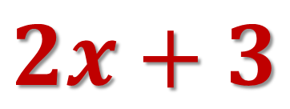

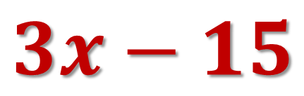


Example 1:
Find the of x. Then find AB and CD.
$$3x−15$$
$$A$$
$$B$$
$$D$$
$$C$$
$$2x+3$$

Slide 5






Properties of Parallelograms:
If a Quadrilateral is a Parallelogram, then its Opposite Angles are Congruent.
$$A$$
$$B$$
$$D$$
$$C$$

Slide 6





Example 2:
Find the of $x$.
$$A$$
$$B$$
$$4x+4$$
$$68°$$
$$D$$
$$C$$

Slide 7




Properties of Parallelograms:
If a Quadrilateral is a Parallelogram, then its Consecutive Angles are Supplementary.
$$A$$
$$B$$
$$x°$$
$$y°$$
$$y°$$
$$x°$$
$$D$$
$$C$$

Slide 8


Properties of Parallelograms:
If a Parallelogram has One Right Angle, then it has Four Right Angles.
$$A$$
$$B$$
$$D$$
$$C$$

Slide 9
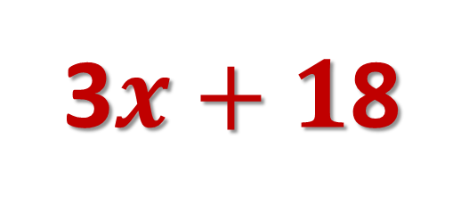
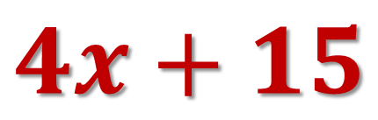
Example 3:
Find x.
$$A$$
$$B$$
3$x+1$8
$$4x+15$$
$$D$$
$$C$$

Slide 10



Diagonals of Parallelograms:
If a Quadrilateral is a Parallelogram, then its Diagonals Bisect Each Other.
$$A$$
$$B$$
$$E$$
$$D$$
$$C$$

Slide 11
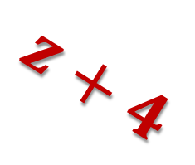
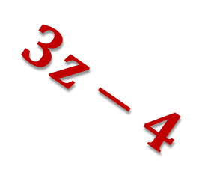
Example 4:
Solve for z.
$$3z−4$$
$$z+4$$

Slide 12





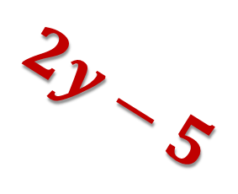

Example 5: Find the Values of the Unknown Values.
$$2y−5$$
$$3z$$
$$5x$$
$$27$$
$$y+4$$
$$33°$$
$$95°$$

Slide 13

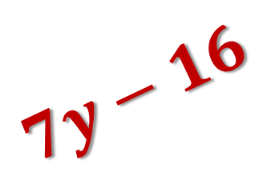

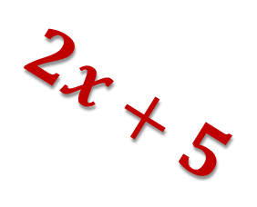
Example 6: Find the Values of the Unknown Values.
$$2x+5$$
$$x$$
$$7y−16$$
$$5y$$

